Slide 1
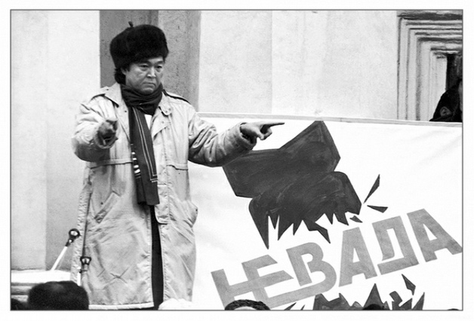
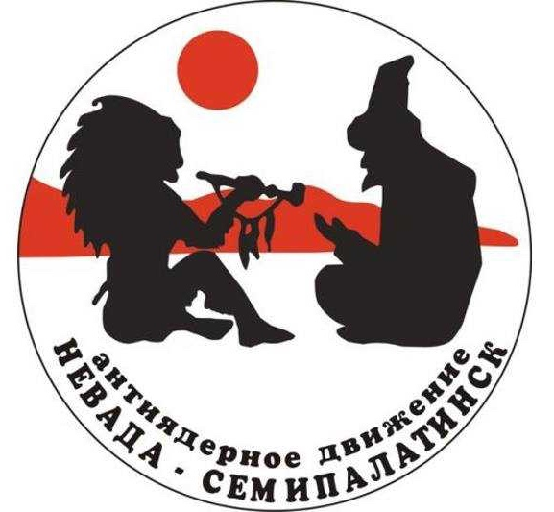
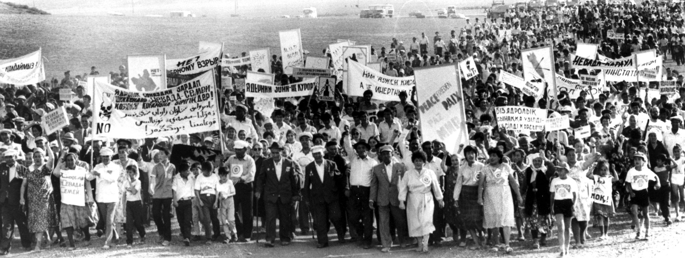
The Nevada-Semipalatinsk Movement: Transnational Activism in a Time of Transition
Matthew Evangelista, Cornell University

Slide 2
The Nevada-Semipalatinsk Movement:
Transnational Activism in a Time of Transition
Events
Consequences
One possible explanation
Background to Kazakhstan’s antinuclear activism
Antecedents to the Nevada movement
  Mukhtar Auezov, Murat Auezov, V.G. Kobrin
Nevada’s relationship to US activists
Nevada’s relationship to Soviet government institutions
Nevada’s relationship to US government institutions

Slide 3
The Nevada-Semipalatinsk Movement:
Transnational Activism in a Time of Transition
Events
Consequences
One possible explanation
Background to Kazakhstan’s antinuclear activism
Antecedents to the Nevada movement
  Mukhtar Auezov, Murat Auezov, V.G. Kobrin
Nevada’s relationship to US activists
Nevada’s relationship to Soviet government institutions
Nevada’s relationship to US government institutions

Slide 4
EVENTS
February 1989:
Olzhas Suleimenov, Kazakh poet and member of USSR Supreme Soviet, founds ”Nevada” movement to end nuclear testing at the Semipalatinsk Test Range and worldwide

Slide 5
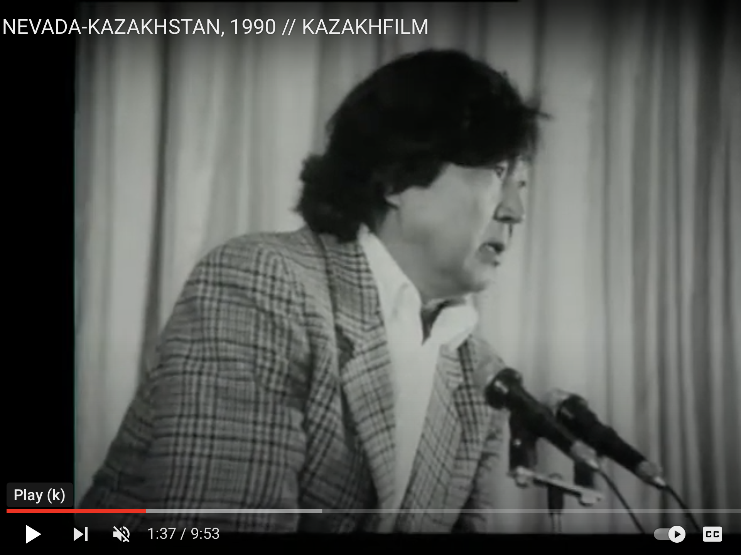

Slide 6
“We called this movement ‘Nevada,’ in the hope that our like-minded counterparts in the American state of Nevada who are blockading the atomic test site there will find us their brothers in trouble.”
“If these two movements unite maybe our voice, supported by public organizations and the peoples of our republic and country and the peoples of foreign countries will force the governments of the atomic club, the states in the atomic club, to sit at the negotiating table and sign an agreement on the final cessation of tests in all spheres.”

Slide 7
EVENTS
February 1989:
Olzhas Suleimenov, Kazakh poet and member of USSR Supreme Soviet, founds ”Nevada” movement to end nuclear testing at the Semipalatinsk Test Range and worldwide
1989-1991:
Hundreds of thousands of Kazakh citizens protest against the test site, and collaborate with foreign supporters in peace marches and an International Citizens Congress (May 1990)

Slide 8
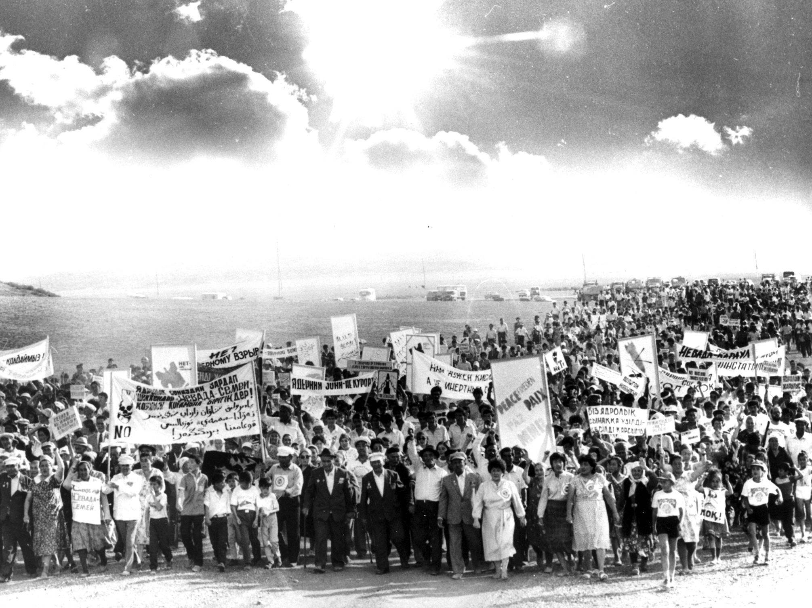

Slide 9
The Nevada-Semipalatinsk Movement:
Transnational Activism in a Time of Transition
Events
Consequences
One possible explanation
Background to Kazakhstan’s antinuclear activism
Antecedents to the Nevada movement
  Mukhtar Auezov, Murat Auezov, V.G. Kobrin
Nevada’s relationship to US activists
Nevada’s relationship to Soviet government institutions
Nevada’s relationship to US government institutions

Slide 10
CONSEQUENCES
1989-1990:
11 out of 18 scheduled nuclear tests cancelled
29 August 1991:
Kazakhstan closes test site
10 September 1996:
United Nations General Assembly adopts Comprehensive Nuclear Test Ban Treaty

Slide 11
The Nevada-Semipalatinsk Movement:
Transnational Activism in a Time of Transition
Events
Consequences
One possible explanation
Background to Kazakhstan’s antinuclear activism
Antecedents to the Nevada movement
  Mukhtar Auezov, Murat Auezov, V.G. Kobrin
Nevada’s relationship to US activists
Nevada’s relationship to Soviet government institutions
Nevada’s relationship to US government institutions

Slide 12

ONE POSSIBLE EXPLANATION
“Would Suleimenov and the Kazakhs have risen up in 1989 if US grassroots antinuclear activists and the Western Shoshone had not paved the way?”
George Gregory Rozsa, “The Nevada Movement: A Model of Trans-Indigenous Antinuclear Solidarity,” Journal of Transnational American Studies, vol. 11, no. 2 (2020).

Slide 13
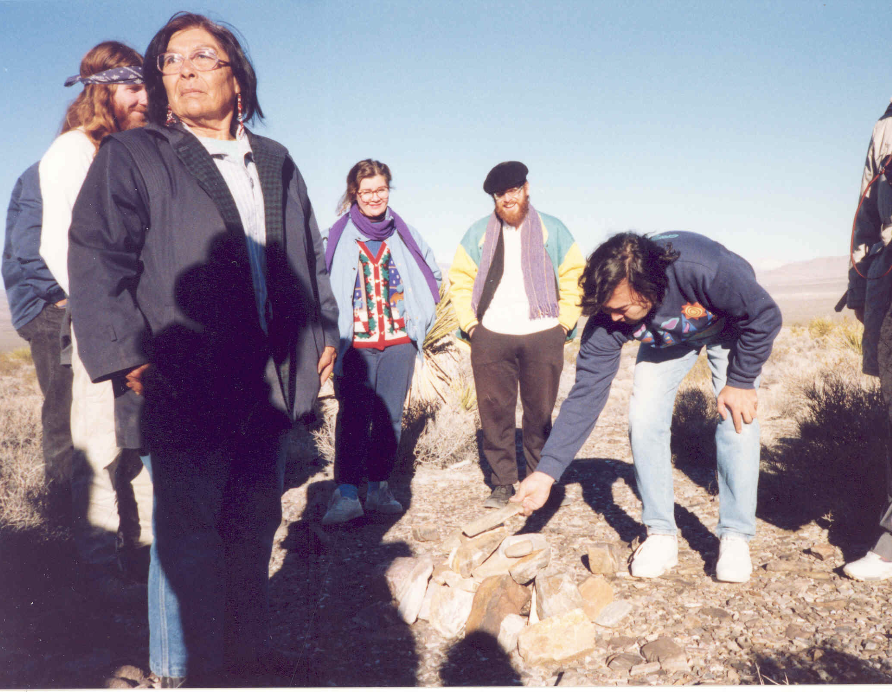

Slide 14
ONE POSSIBLE EXPLANATION
“Western Shoshone activism at the Nevada Test Site provided proof and inspiration that Indigenous people could fight back against their nuclear colonial oppressors.”
Their transnational collaboration with Kazakh counterparts “had a material effect on the direction of Nevada-Semipalatinsk’s operational tactics.”
Previous accounts “overlooked or chosen to ignore Nevada-Semipalatinsk’s transnational and Indigenous dimensions.”
George Gregory Rozsa, “The Nevada Movement: A Model of Trans-Indigenous Antinuclear Solidarity,” Journal of Transnational American Studies, vol. 11, no. 2 (2020).

Slide 15
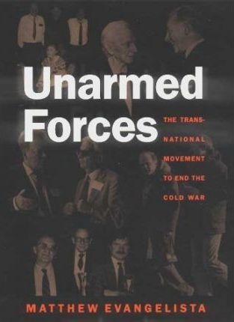
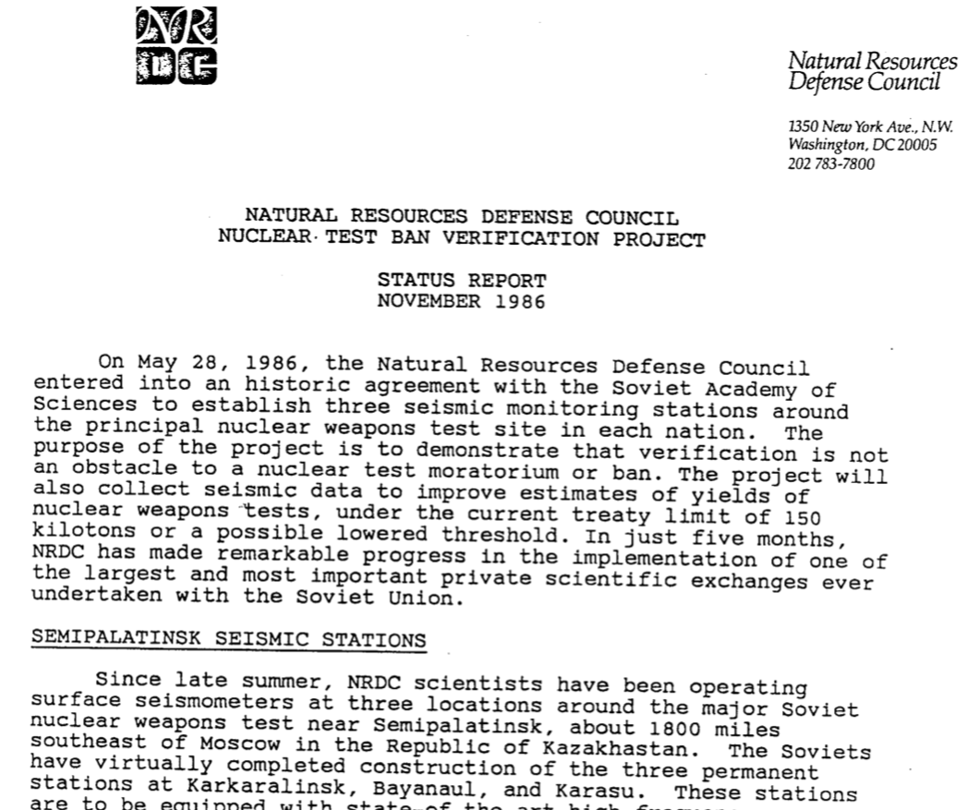
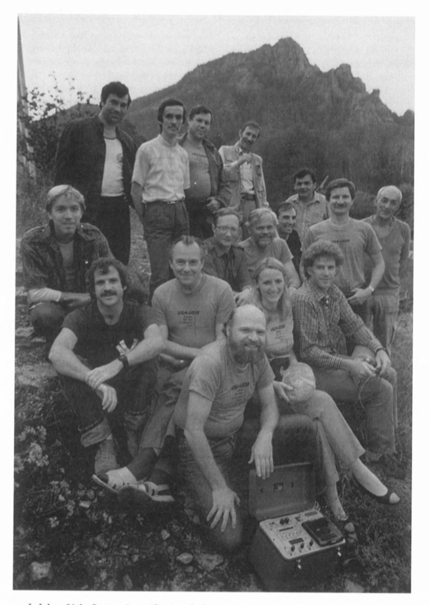
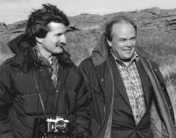
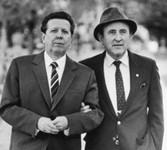
NRDC-SAS
Thomas Cochran Evgenii Velikhov
Evgenii Chazov Bernard Lown

Slide 16
The Nevada-Semipalatinsk Movement:
Transnational Activism in a Time of Transition
Events
Consequences
One possible explanation
Background to Kazakhstan’s antinuclear activism
Antecedents to the Nevada movement
  Mukhtar Auezov, Murat Auezov, V.G. Kobrin
Nevada’s relationship to US activists
Nevada’s relationship to Soviet government institutions
Nevada’s relationship to US government institutions

Slide 17
Background to Kazakhstan’s antinuclear activism
21 August 1947: Semipalatinsk nuclear test range established
29 August 1949: First test of a Soviet atomic weapon
1949-1989:
456 nuclear explosions
116 in the atmosphere 340 underground
Residents from nearby villages, such as Karaul, Dolon, Sarzhal, and Kainar, suffered high incidences of cancer and birth defects
The Semei Nuclear Medicine and Oncology Center estimated that at least 60,000 people have been afflicted by diseases linked to nuclear radiation from the test site and more than 1.5 million people have been affected overall through three generations of genetic mutations

Slide 18
The Nevada-Semipalatinsk Movement:
Transnational Activism in a Time of Transition
Events
Consequences
One possible explanation
Background to Kazakhstan’s antinuclear activism
Antecedents to the Nevada movement
  Mukhtar Auezov, Murat Auezov, V.G. Kobrin
Nevada’s relationship to US activists
Nevada’s relationship to Soviet government institutions
Nevada’s relationship to US government institutions

Slide 19
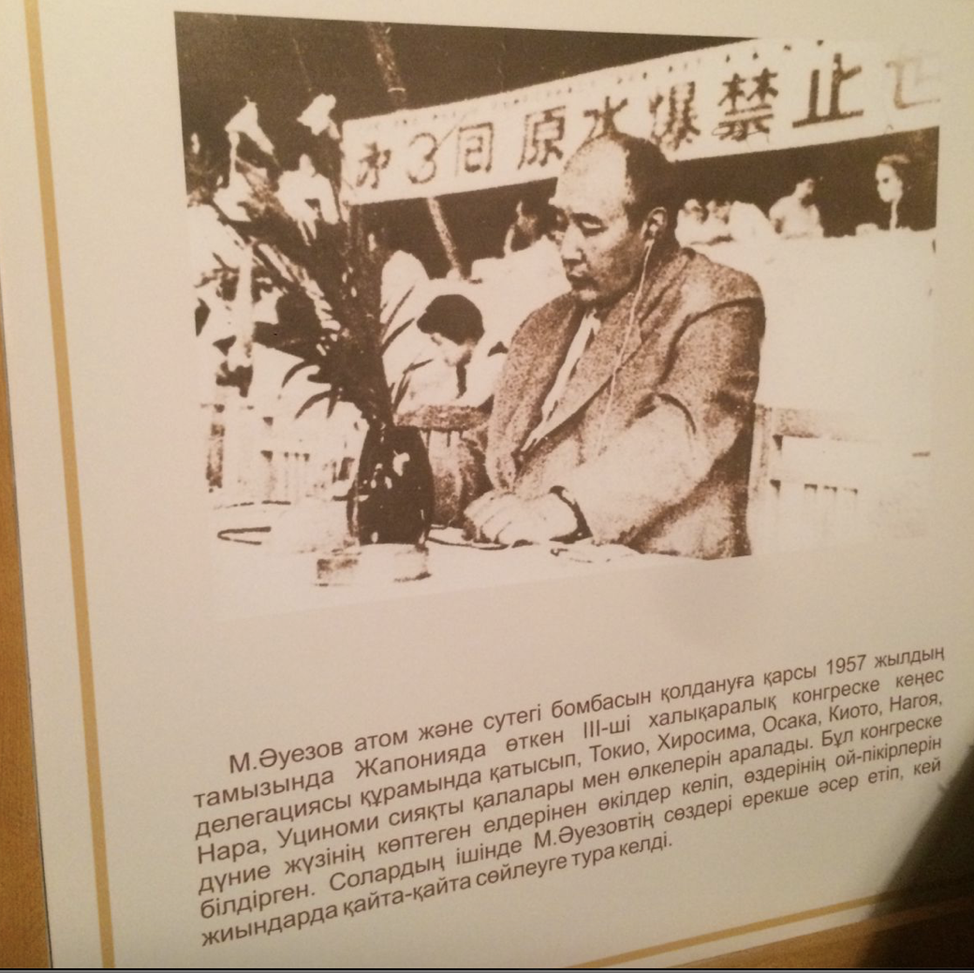

Slide 20
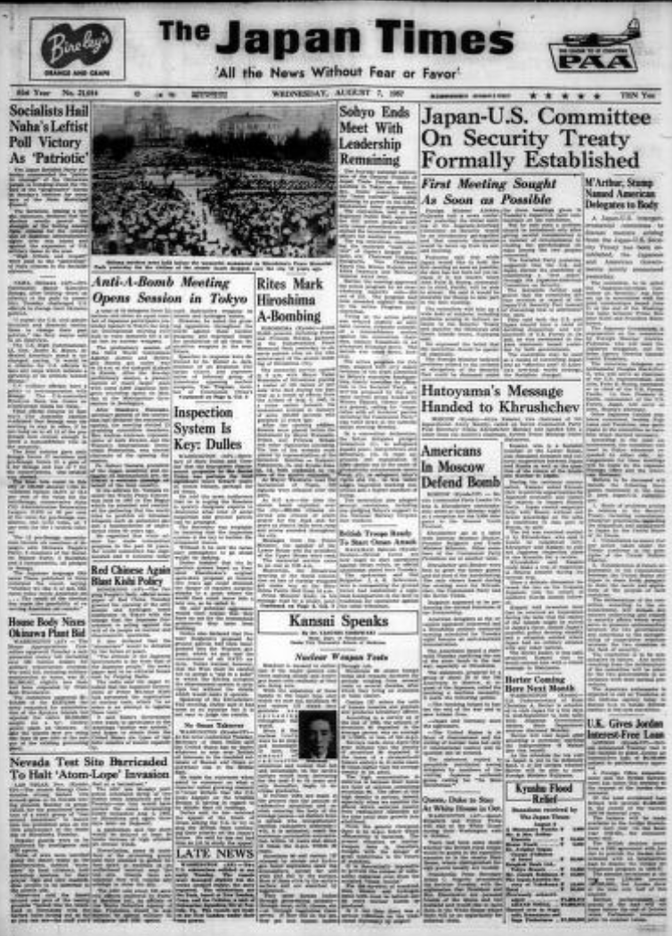
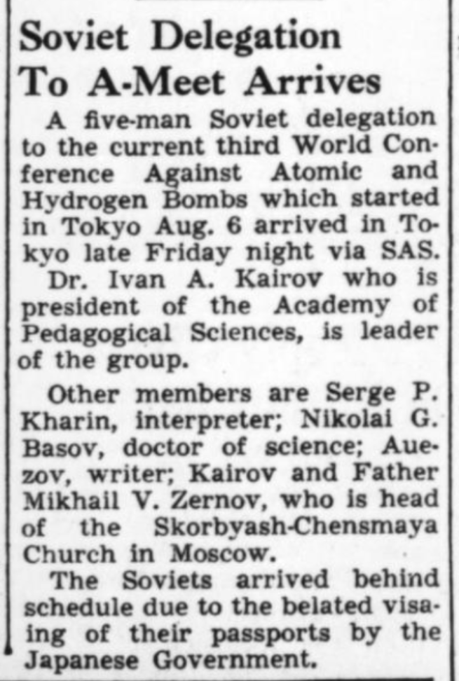
Japan Times, 11 August 1957

Slide 21
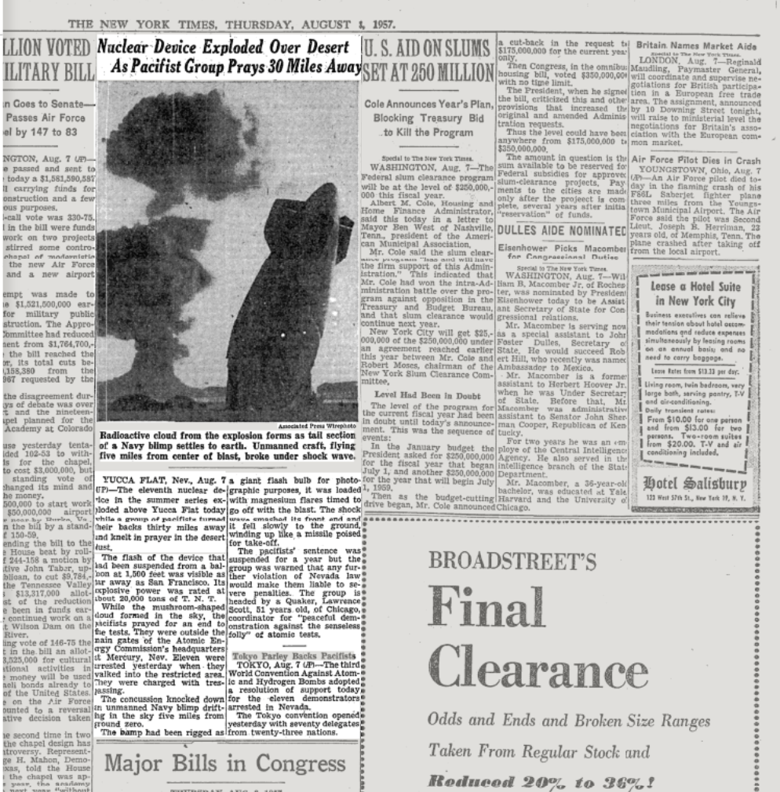

Slide 22
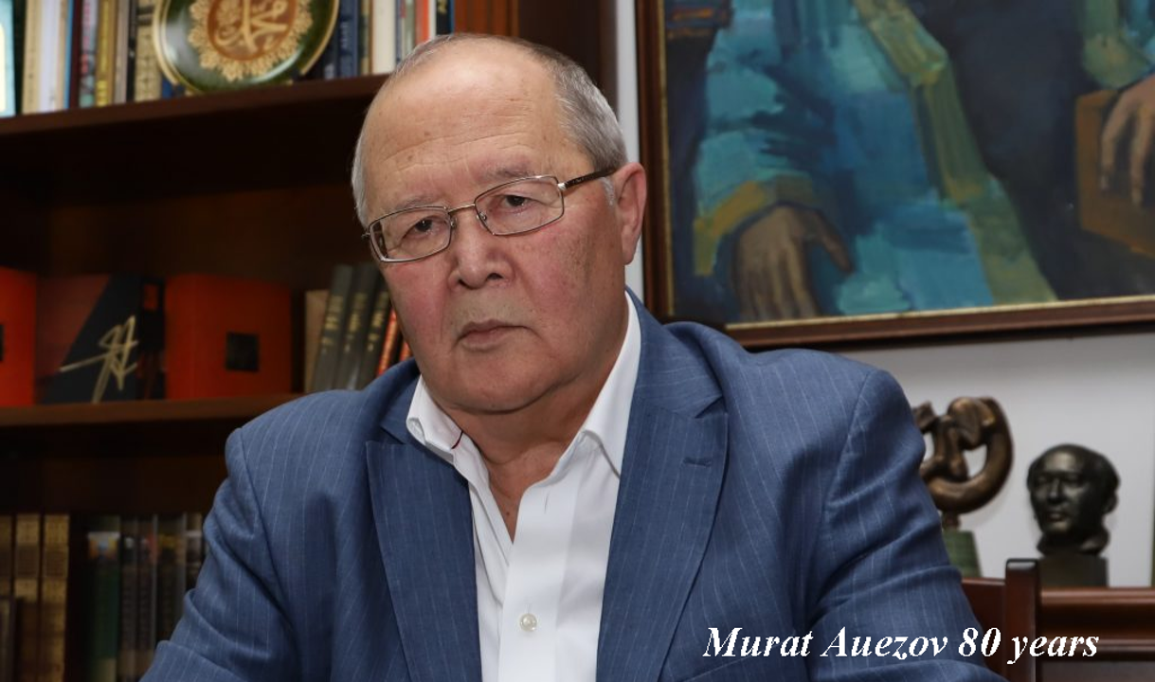
“Members of the Zhas Tulpar movement were at the forefront of progressive social movements in later years, such as the Nevada-Semipalatinsk International Anti-Nuclear Movement.”
--Aibarshyn Akhmetkali

Slide 23
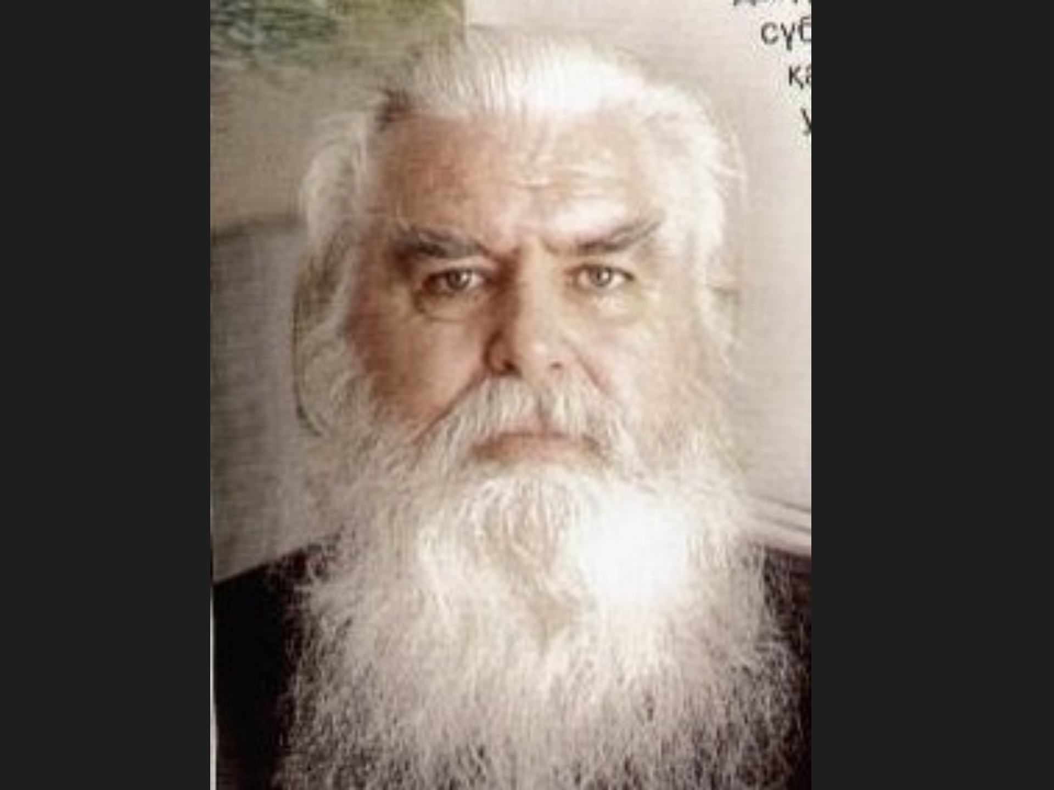

Slide 24
The Nevada-Semipalatinsk Movement:
Transnational Activism in a Time of Transition
Events
Consequences
One possible explanation
Background to Kazakhstan’s antinuclear activism
Antecedents to the Nevada movement
  Mukhtar Auezov, Murat Auezov, V.G. Kobrin
Nevada’s relationship to US activists
Nevada’s relationship to Soviet government institutions
Nevada’s relationship to US government institutions

Slide 25
In Rozsa’s view, Suleimenov’s choice of co-sponsors for the Congress—the International Physicians for the Prevention of Nuclear War (IPPNW) and the Federation of American Scientists (FAS)—"would give the conference a decidedly technocratic and autocratic character, alienating Western grassroots organizations more closely aligned with the Nevada movement, organizations that provided the bulk of the day-to-day and joint US-Kazakh coordinating efforts.”
Rozsa, “Nevada Movement,” 106-107.

Slide 26
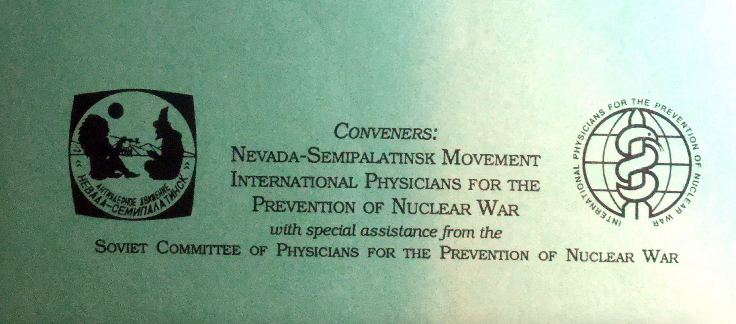

Slide 27
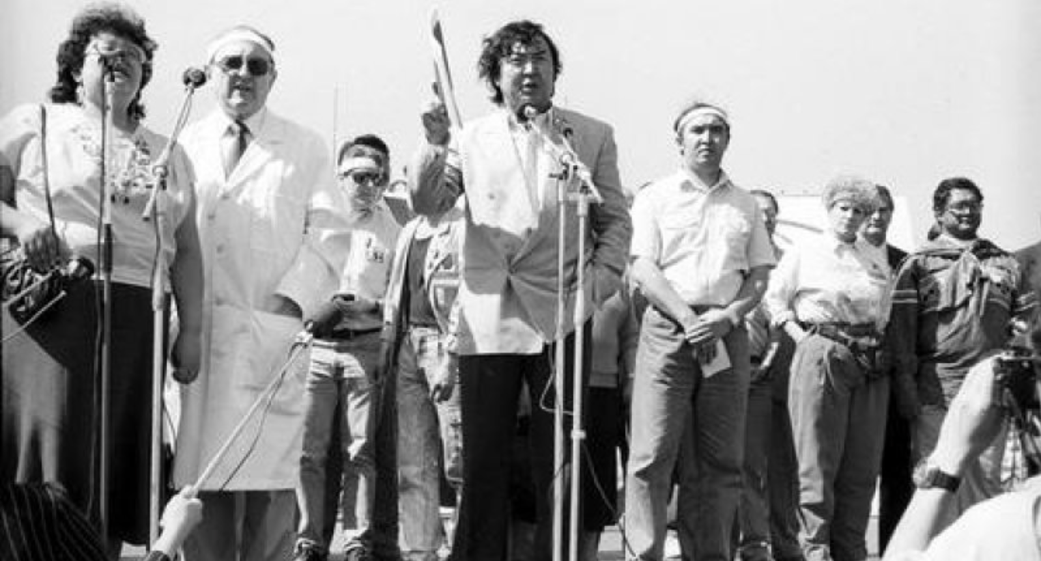

Slide 28
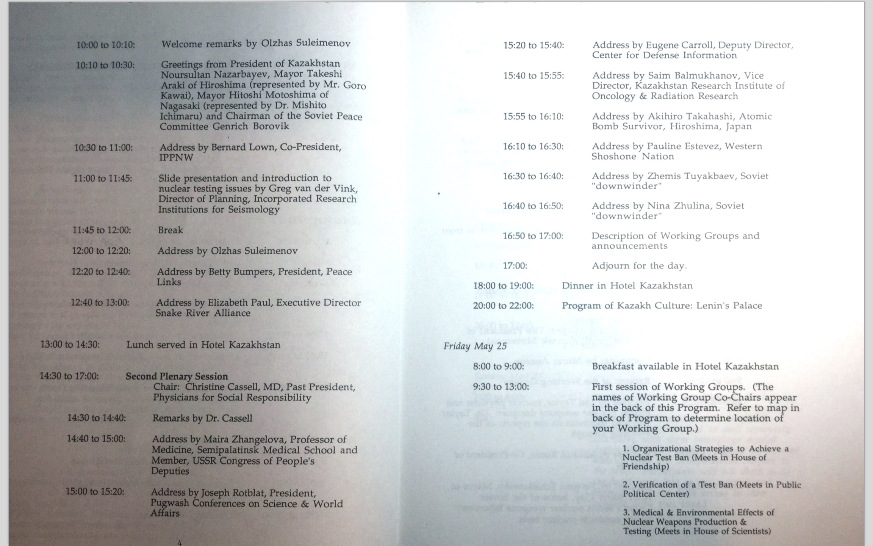


Elizabeth Paul, Snake River Alliance
Pauline Esteves, Western Shoshone Nation
Program for International Citizens Congress, 24 May 1990

Slide 29
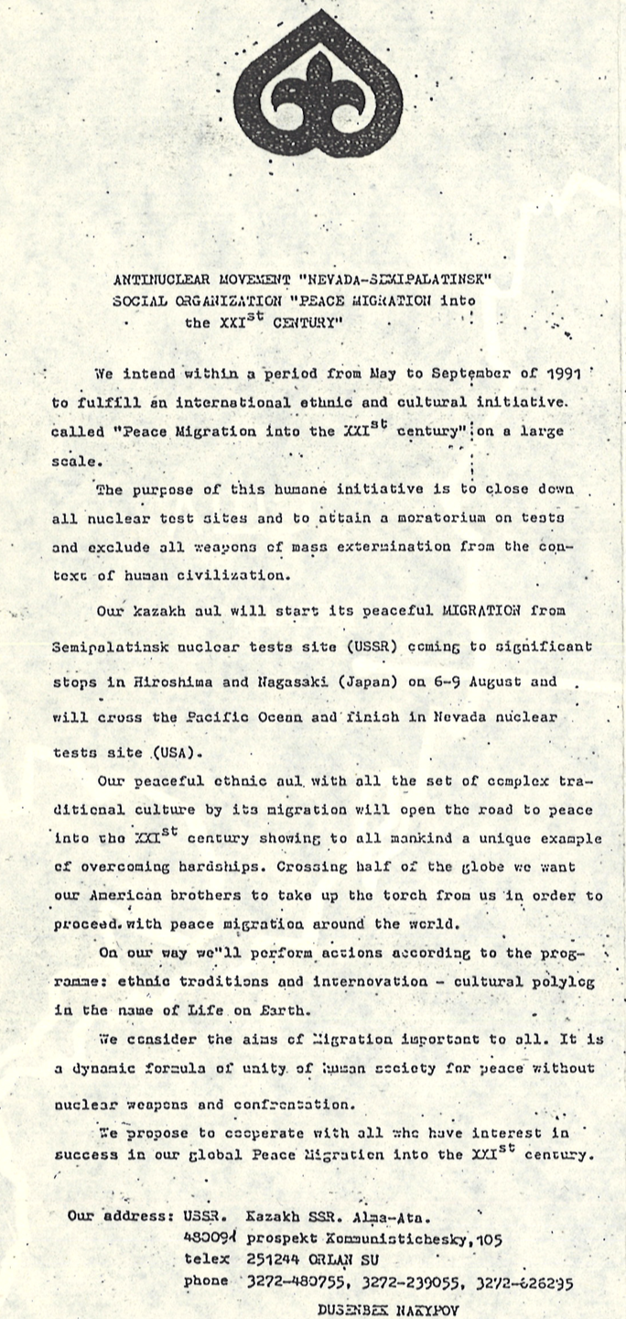
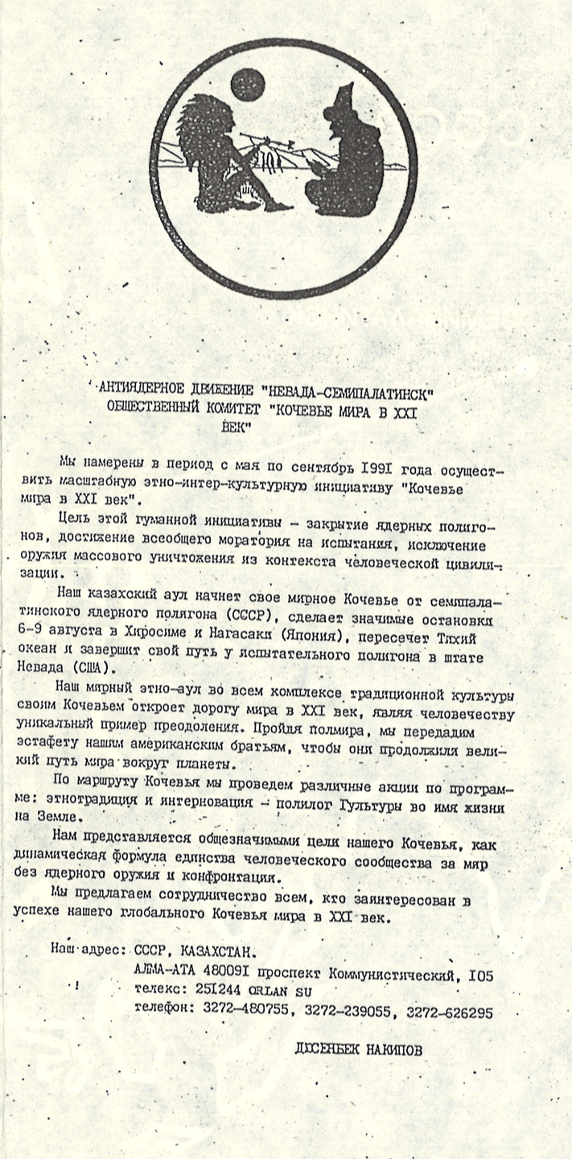
A peace march started in May 1991 in Semipalatinsk and went on to Hiroshima and Nagasaki and then to Nevada. The Kazakh organizers called it a “migration,” using the Russian word kochev’e that means “nomad camp.”

Slide 30
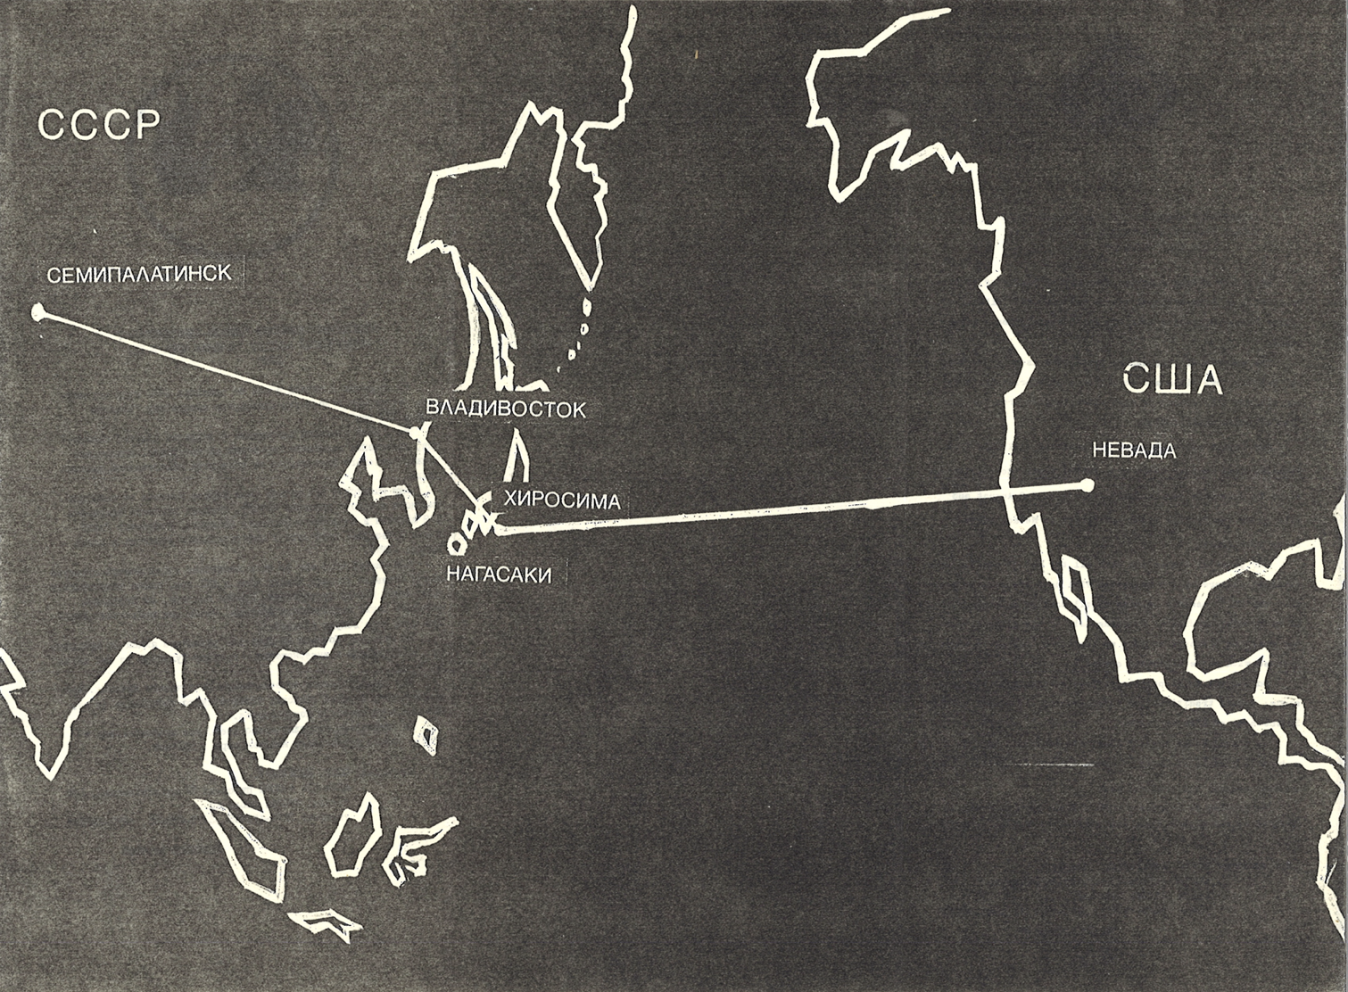

Slide 31


Slide 32
The Nevada-Semipalatinsk Movement:
Transnational Activism in a Time of Transition
Events
Consequences
One possible explanation
Background to Kazakhstan’s antinuclear activism
Antecedents to the Nevada movement
  Mukhtar Auezov, Murat Auezov, V.G. Kobrin
Nevada’s relationship to US activists
Nevada’s relationship to Soviet government institutions
Nevada’s relationship to US government institutions

Slide 33
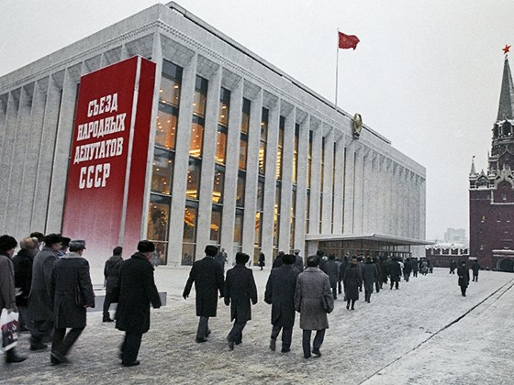

Slide 34
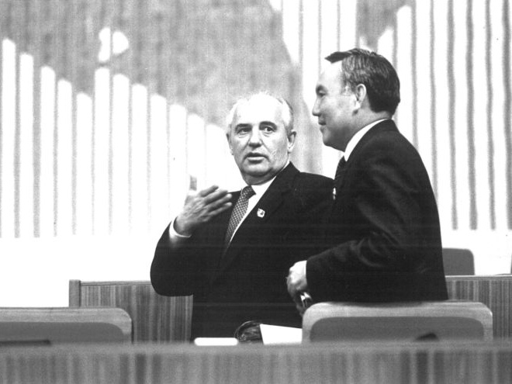

Slide 35
The Nevada-Semipalatinsk Movement:
Transnational Activism in a Time of Transition
Events
Consequences
One possible explanation
Background to Kazakhstan’s antinuclear activism
Antecedents to the Nevada movement
  Mukhtar Auezov, Murat Auezov, V.G. Kobrin
Nevada’s relationship to US activists
Nevada’s relationship to Soviet government institutions
Nevada’s relationship to US government institutions

Slide 36
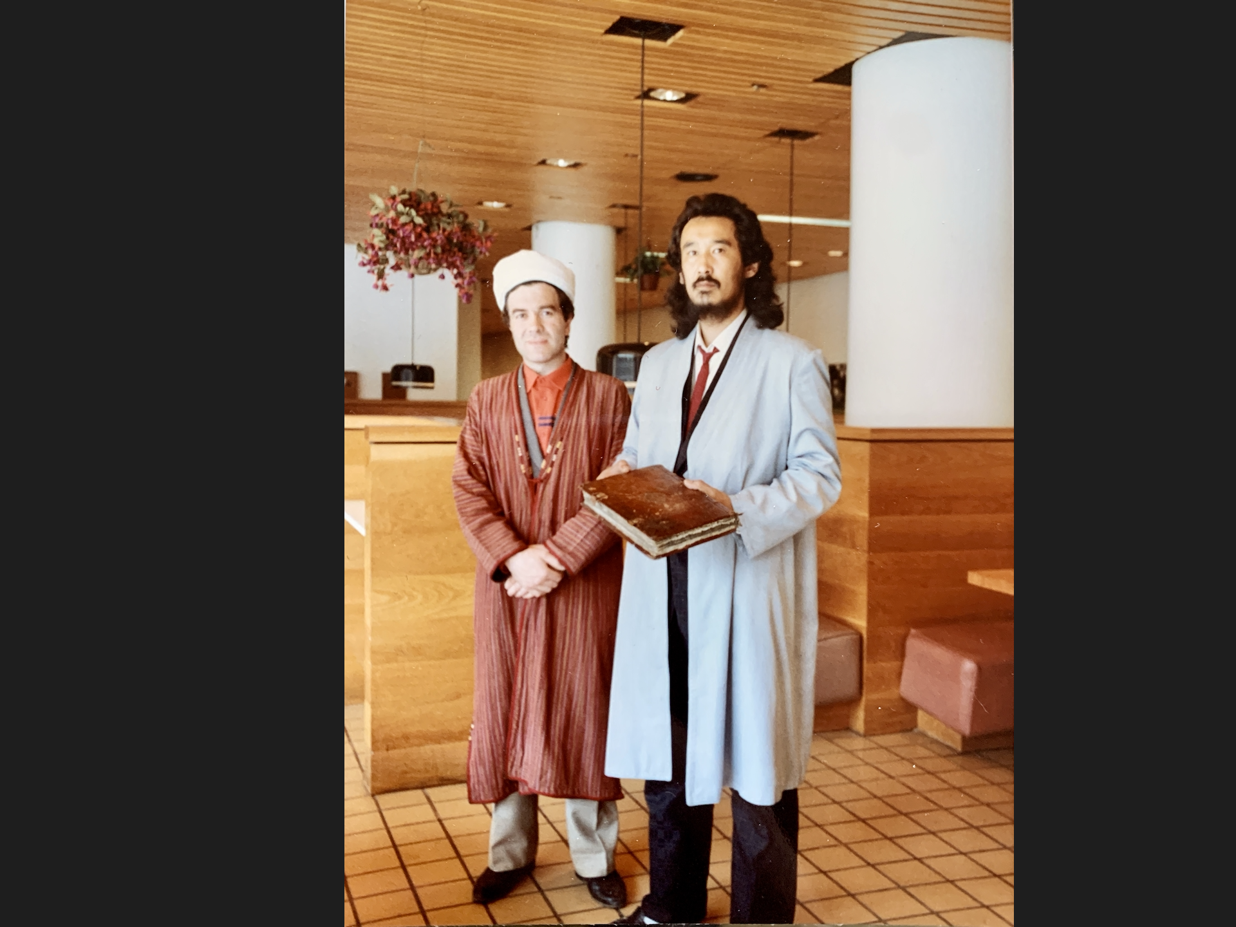
Almaz Estekov

Slide 37
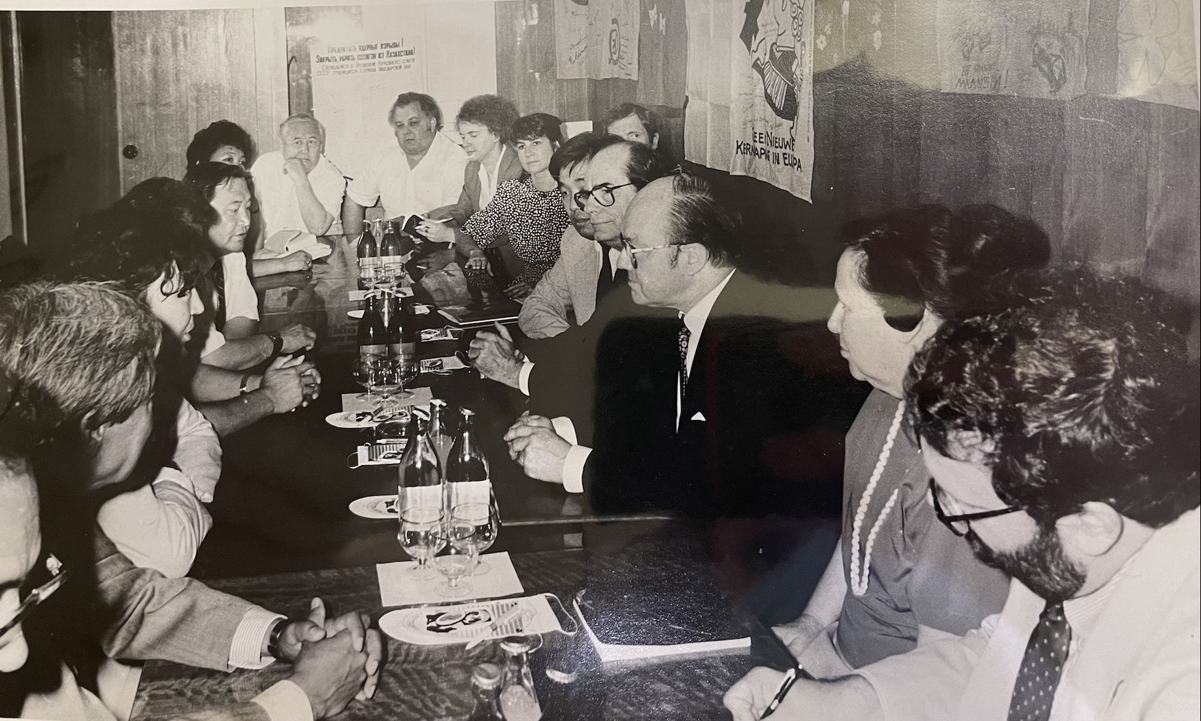

Slide 38
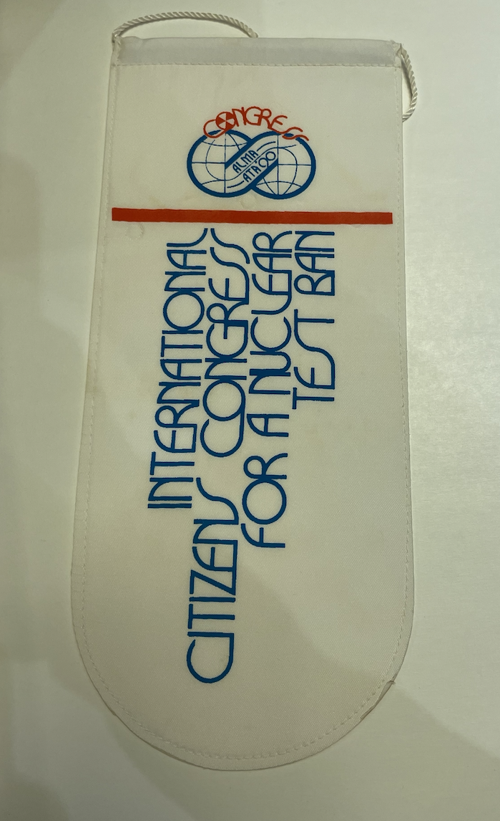
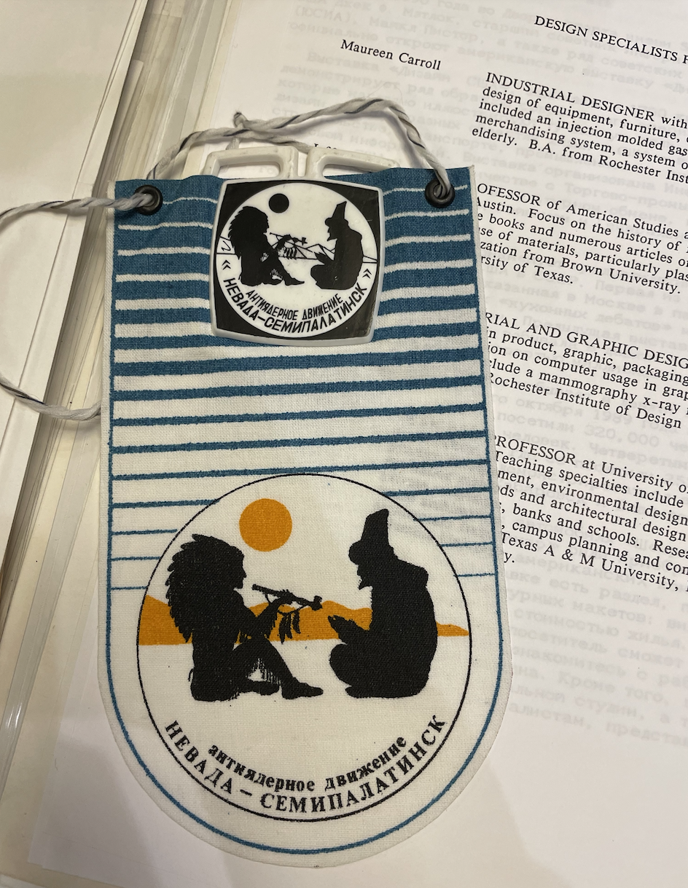

Slide 39
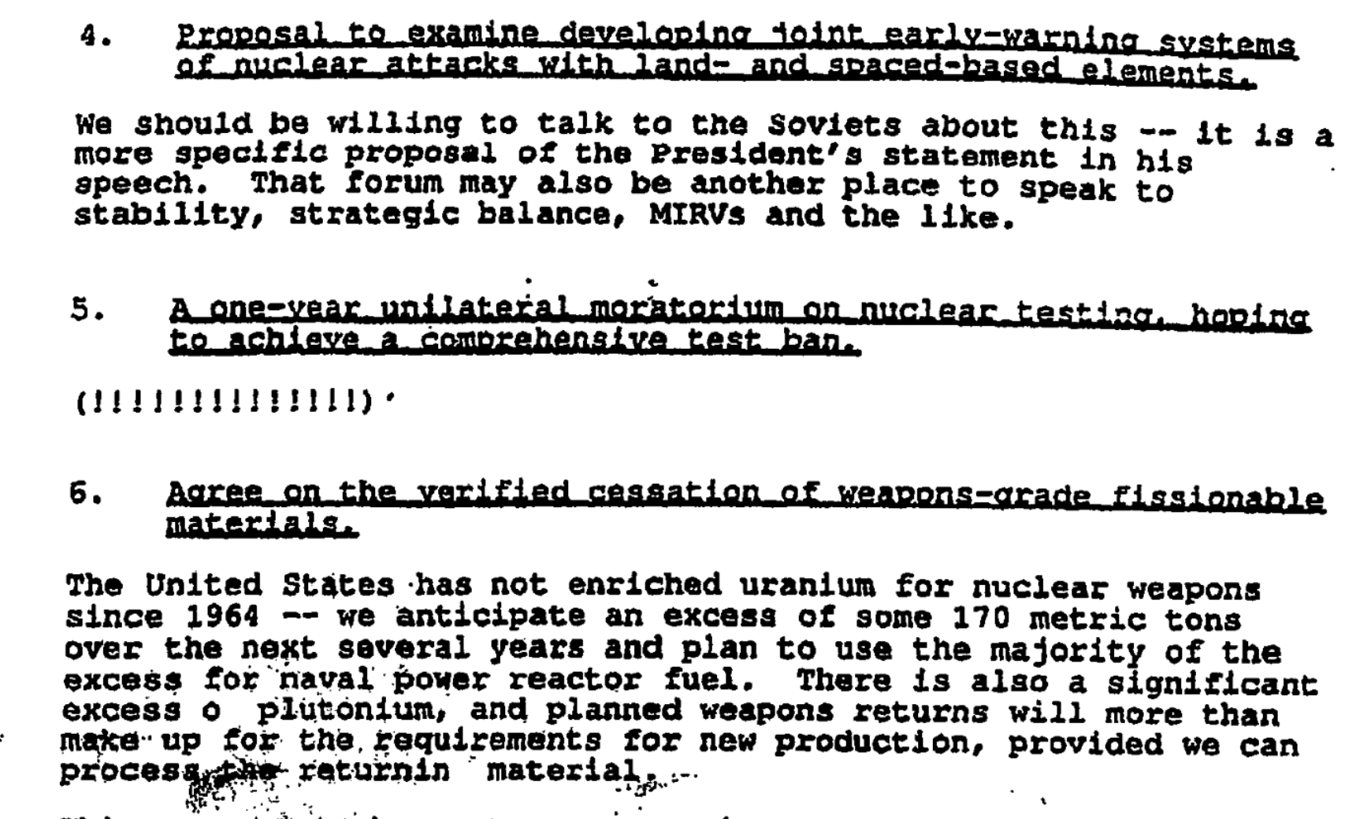

US reactions to Gorbachev’s proposal
for a mutual test moratorium
National Security Council Memo from John Gordon to Ambassador Reginald Bartholomew, "Nuclear Initiatives Discussion Paper," Secret, 10 October 1991, https://nsarchive.gwu.edu/document/22057-document-12-national-security-council-memo.

Slide 40
Long-term impact of Nevada movement on nuclear testing
United Nations General Assembly approved a Comprehensive Nuclear Test Ban Treaty in September 1996 by a vote of 158 to 3, with five abstentions.
Russia signs (Sept 1996) and ratifies (June 2000).
US signs (Sept 1996), but Senate rejects the treaty by a vote of 51 to 48 (October 1999).
Although 178 states have ratified the treaty to date, it will not go into effect until the following countries do so: China, India, Pakistan, North Korea, Israel, Iran, Egypt, and the United States.
Thus, the dream of the Nevada movement to put a permanent end to nuclear weapons tests fell short.

Slide 41
Thank you!
Рахмет!
Спасибо!

